Slide 1
Shipment Delivery Prediction Using AI/ML
Group 4
Mentor Name: Neha Ramchandani
17 April 2022
Team Members:
Chaitravi Angane
Omkar Bhagwat
Mininath R. Nighot
Yogita Mishra

Slide 2
Business Problem
Problem Statement:
E-commerce company that has its own shipment service. There are 3 shipment mode available: Flight, Ship, and Road. The company's motto is "Your order is our happiness,
and your happiness is our pride”. Now as things stand, Company has a 59.7% late shipment rate which means the
majority of the shipment is arriving late. Objective: Create a model to predict the shipment arrival; so that the company knows which
products are going to arrive late.

Slide 3
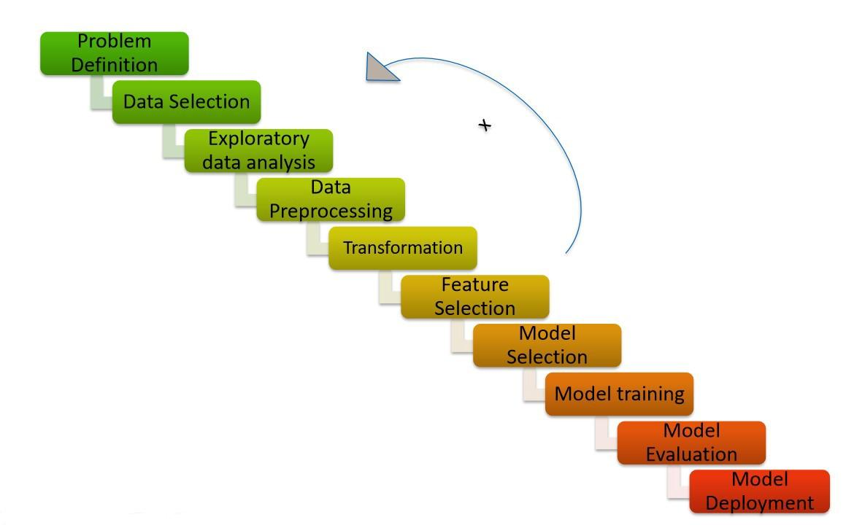
Project Flow

Slide 4
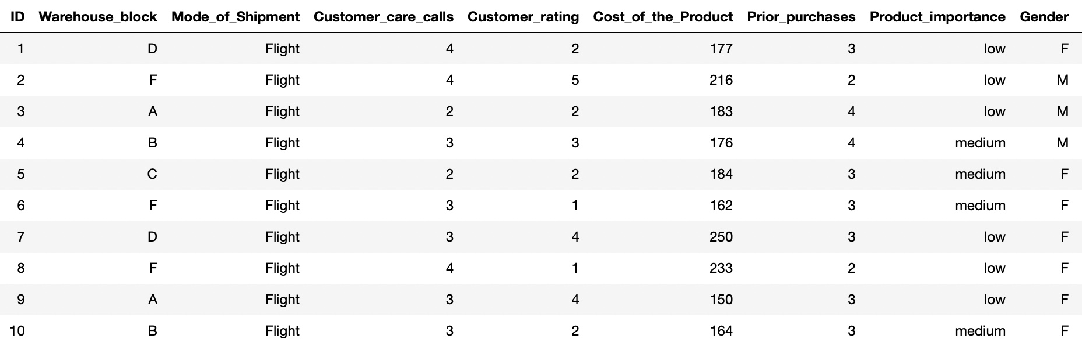
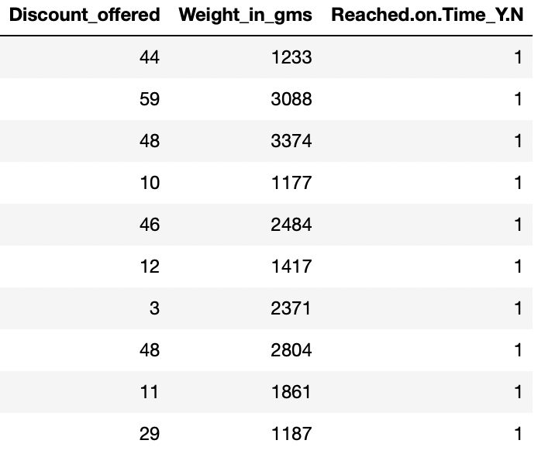
Data set

Slide 5
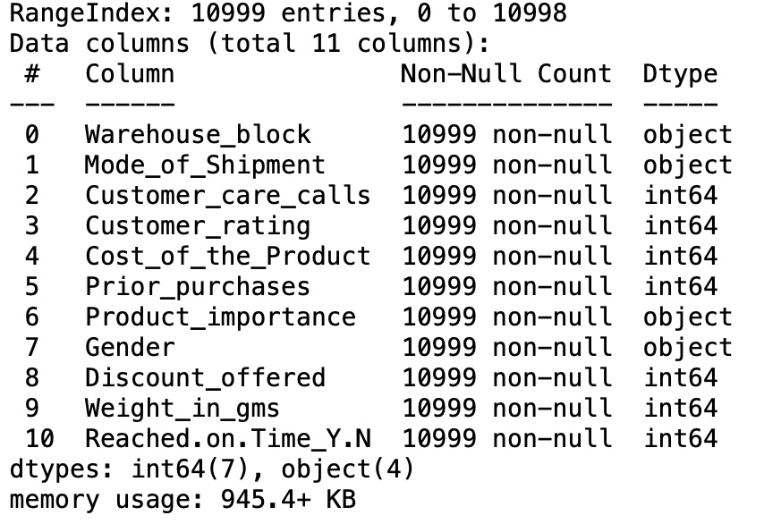
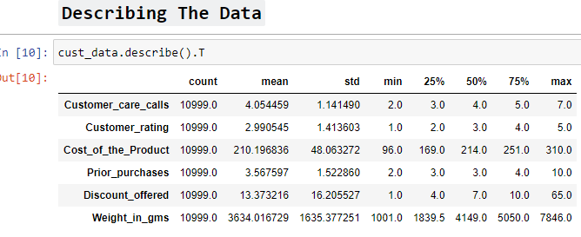
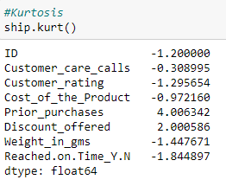
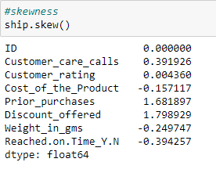
Dataset Details
No. of Rows: 10999 Rows
No. of Columns: 11 Columns
Data Type: Object and Integer
Missing Values: No Null values

Slide 6
EDA
Almost 60% parcels are not reaching on-time.
Most of the shipments are routed by ‘Ship’ ~ 68%.
Block “F” looks most busiest warehouse.
Gender has no correlation to on-time or delayed delivery.
From discount offer & Shipment trends, we can see that higher the discount, the shipment is late.
Column “ID” has been removed.

Slide 7
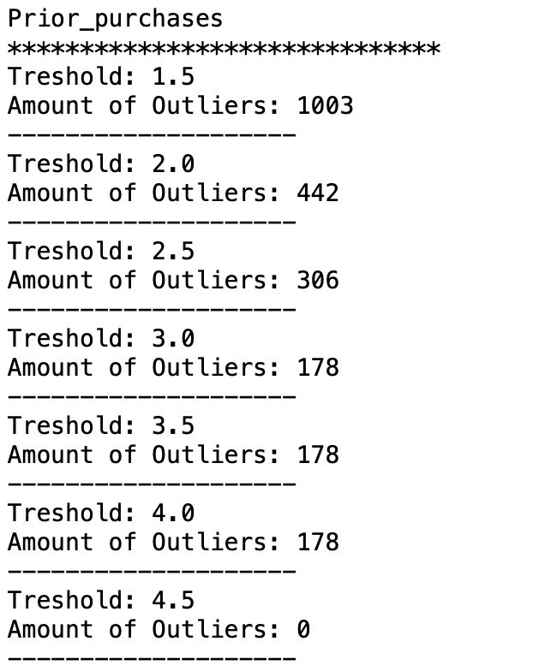
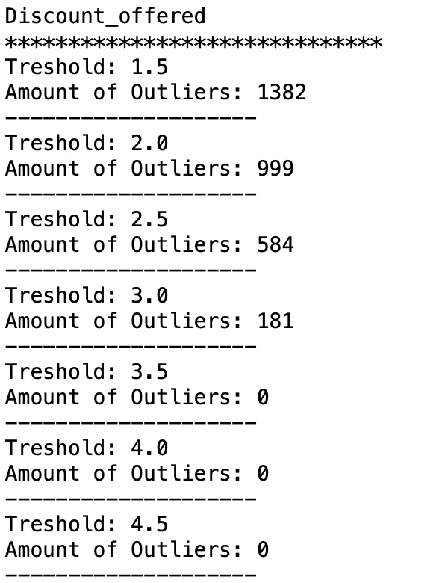
Removing Outliers Outliers in Prior Purchases & Discount Offer
We Can See That There's 1003 Outliers in Prior Purchases & 1382 Outlier in Discount.

Slide 8
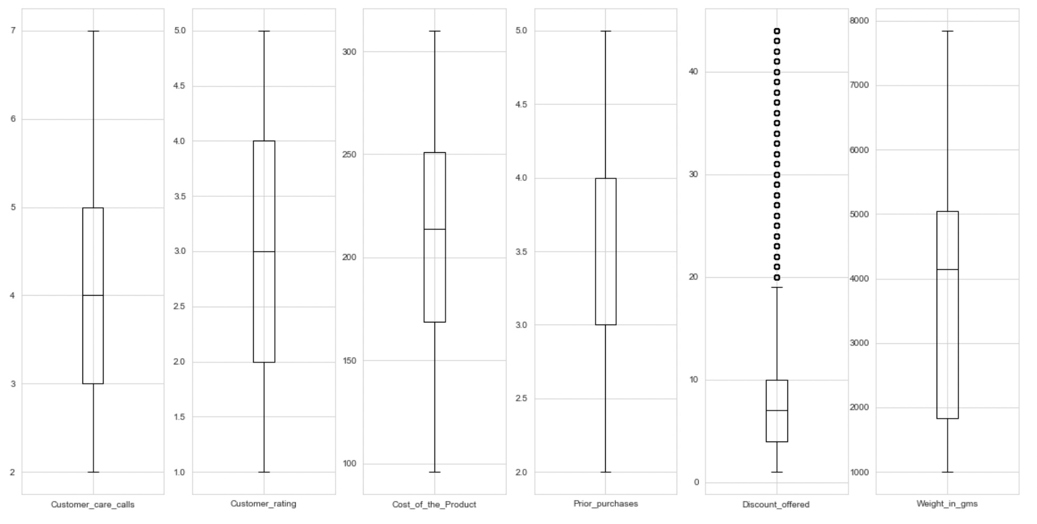
After Removing Outliers

Slide 9
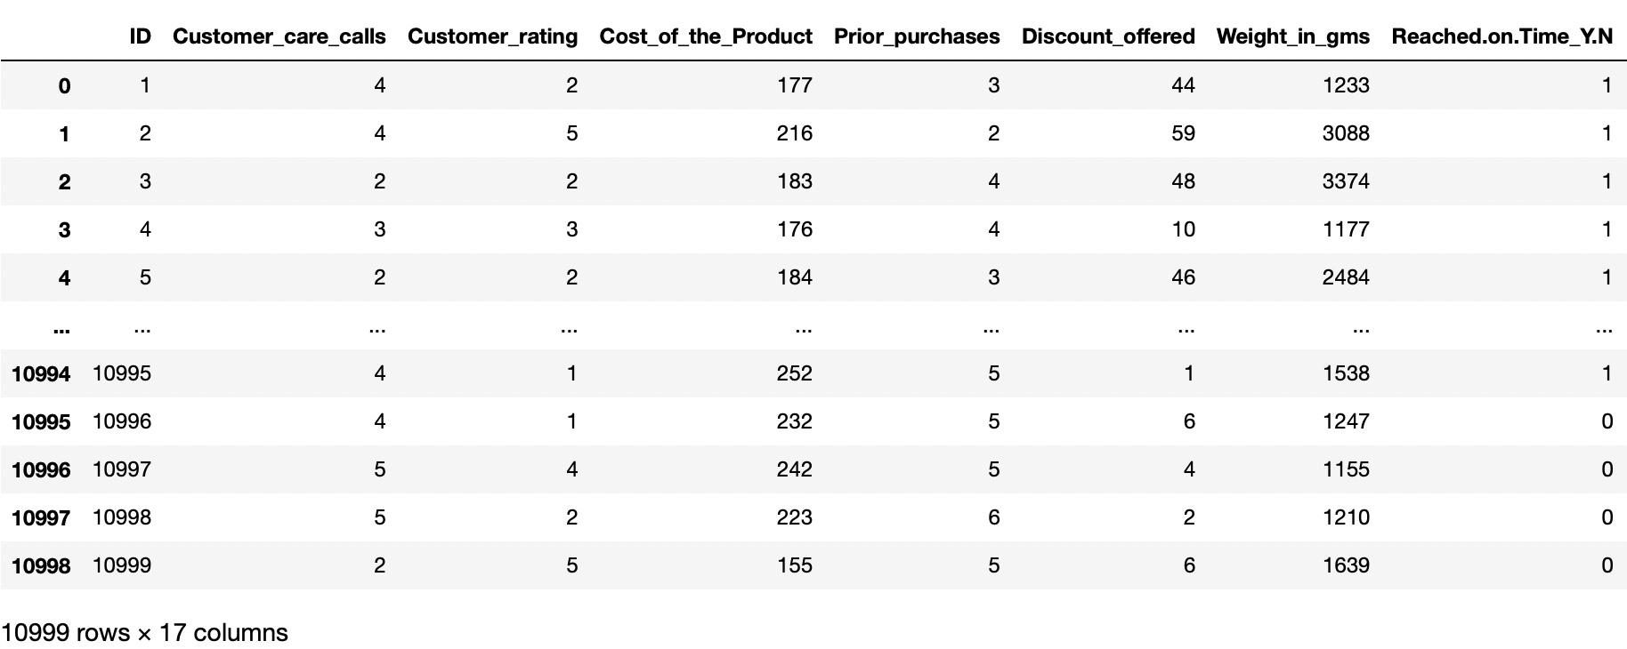
Creating Dummies Variables

Slide 10
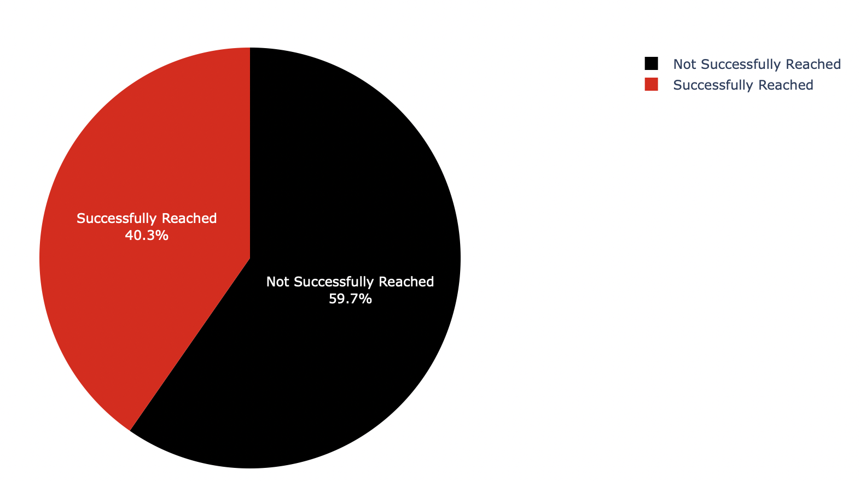
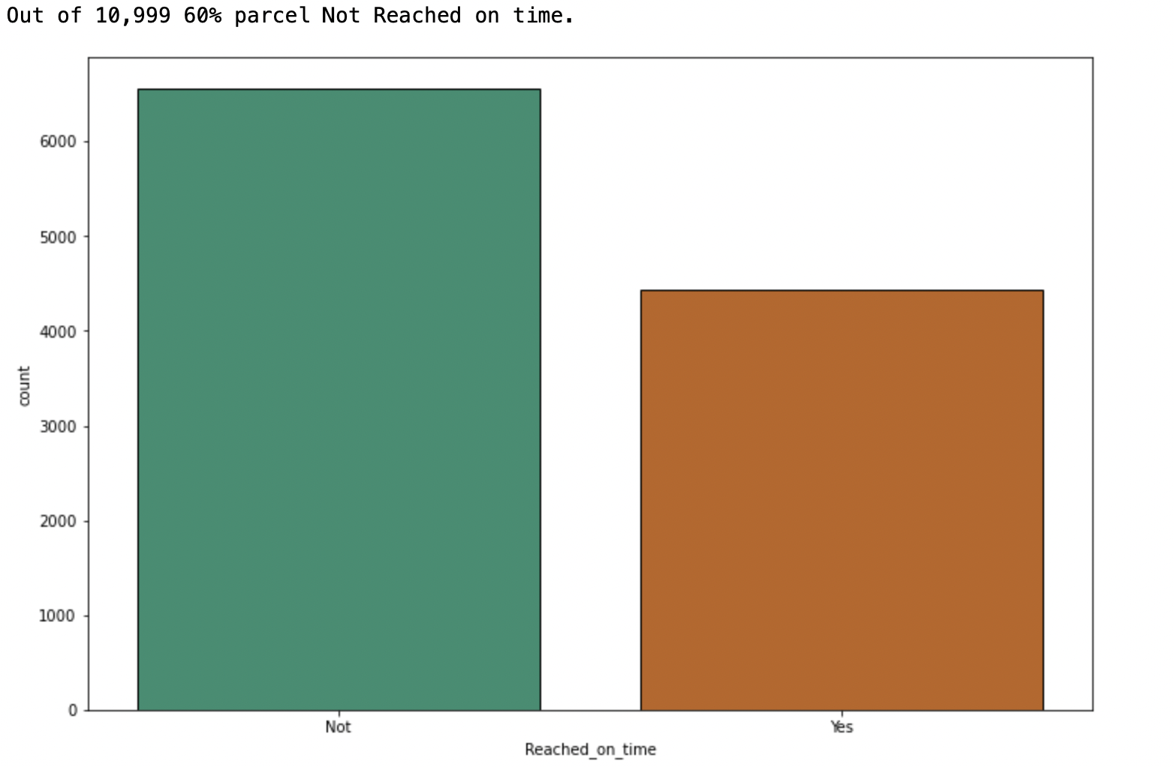
EDA Visualisation
Number Of Product Reached On Time Is More Than Not Reached On Time.
Number Of Not Reached On Time: 6563
Number Of Reached On Time: 4436

Slide 11
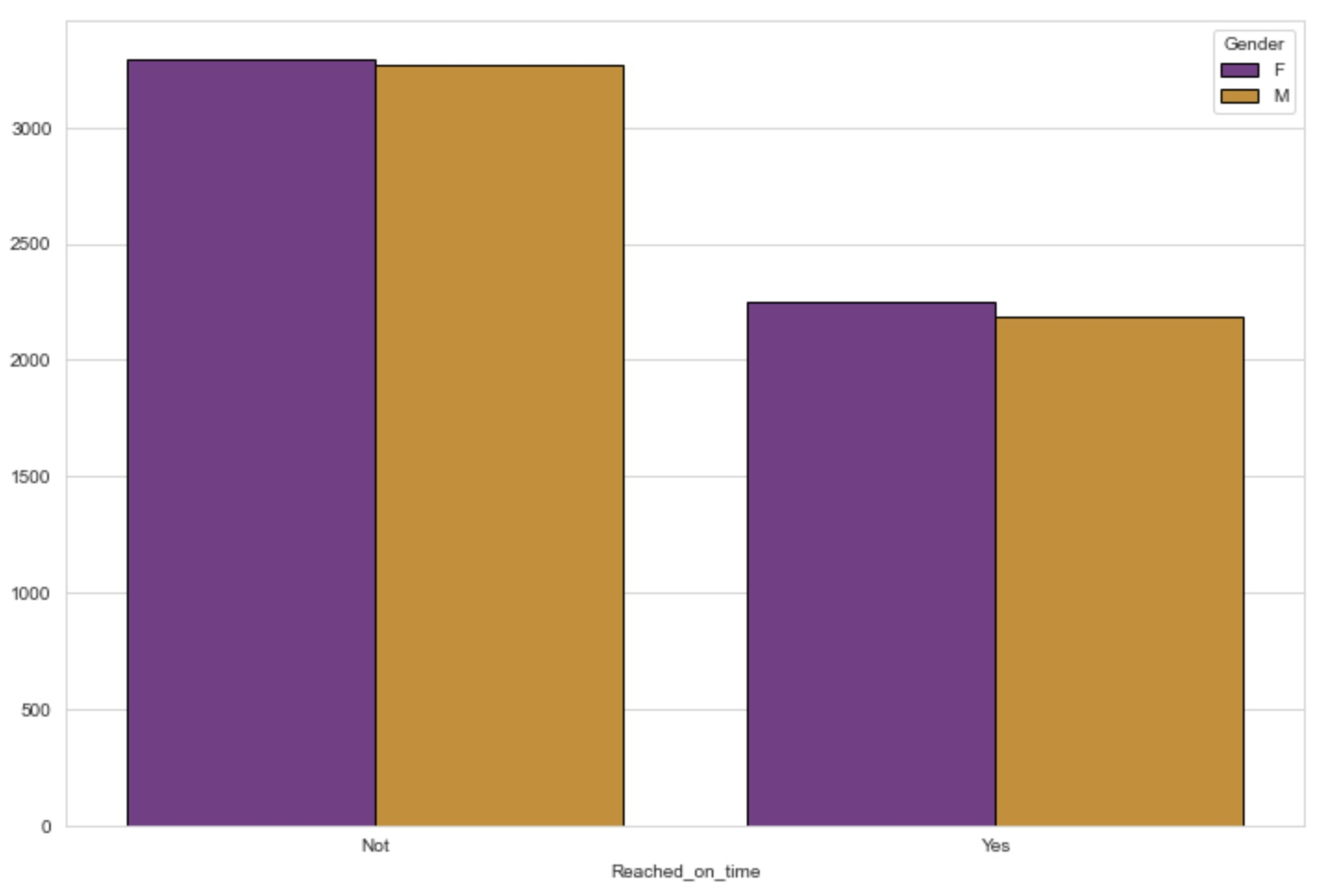
Reached On Time By Gender
There’s Doesn't Have Much Variance In Gender Column.

Slide 12
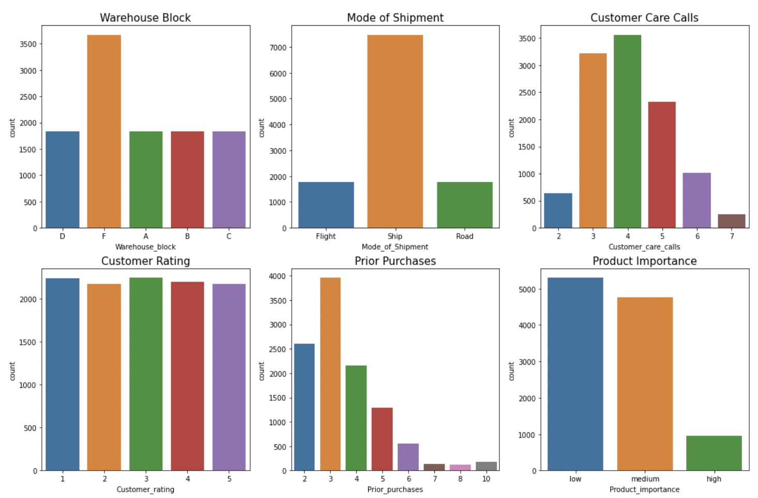
Visualization

Slide 13
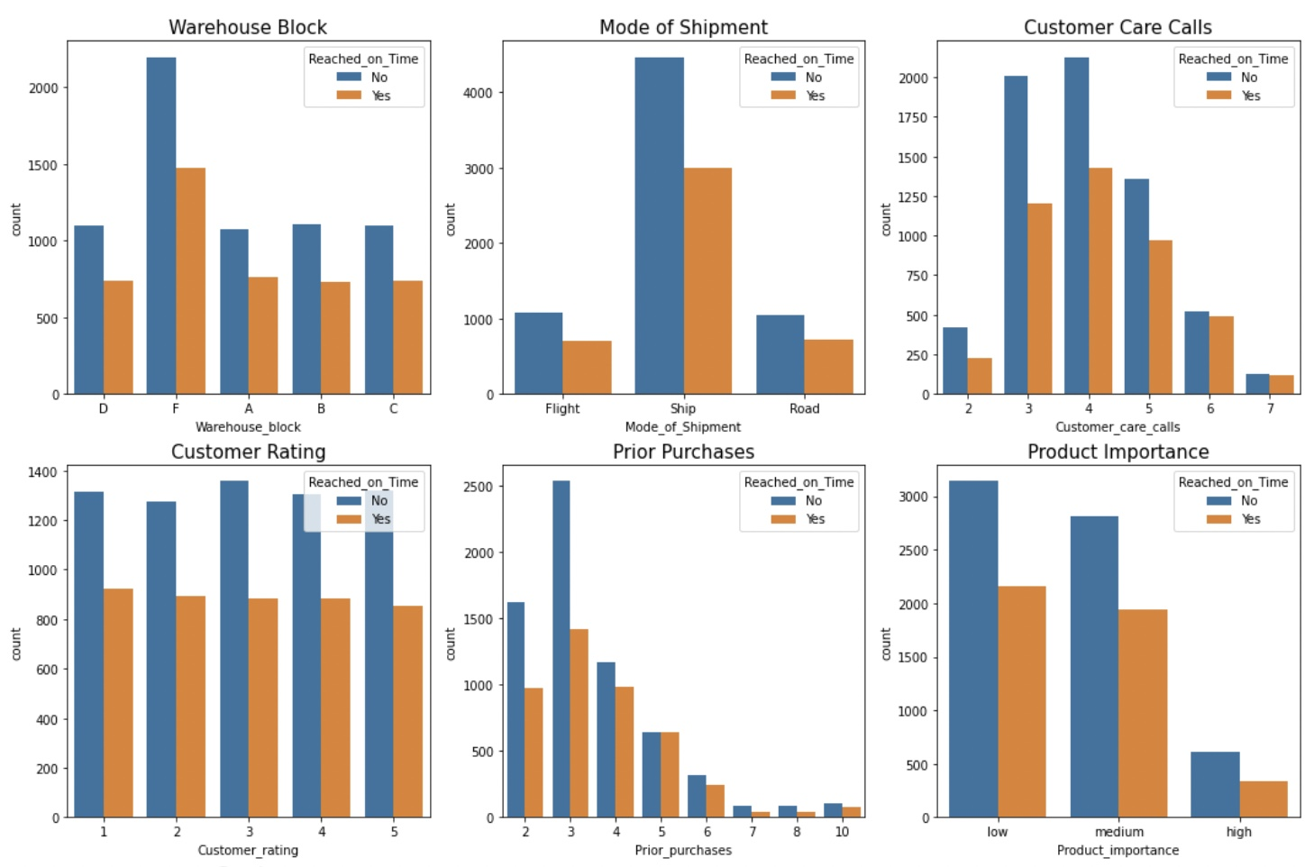
Reached on Time or Not

Slide 14
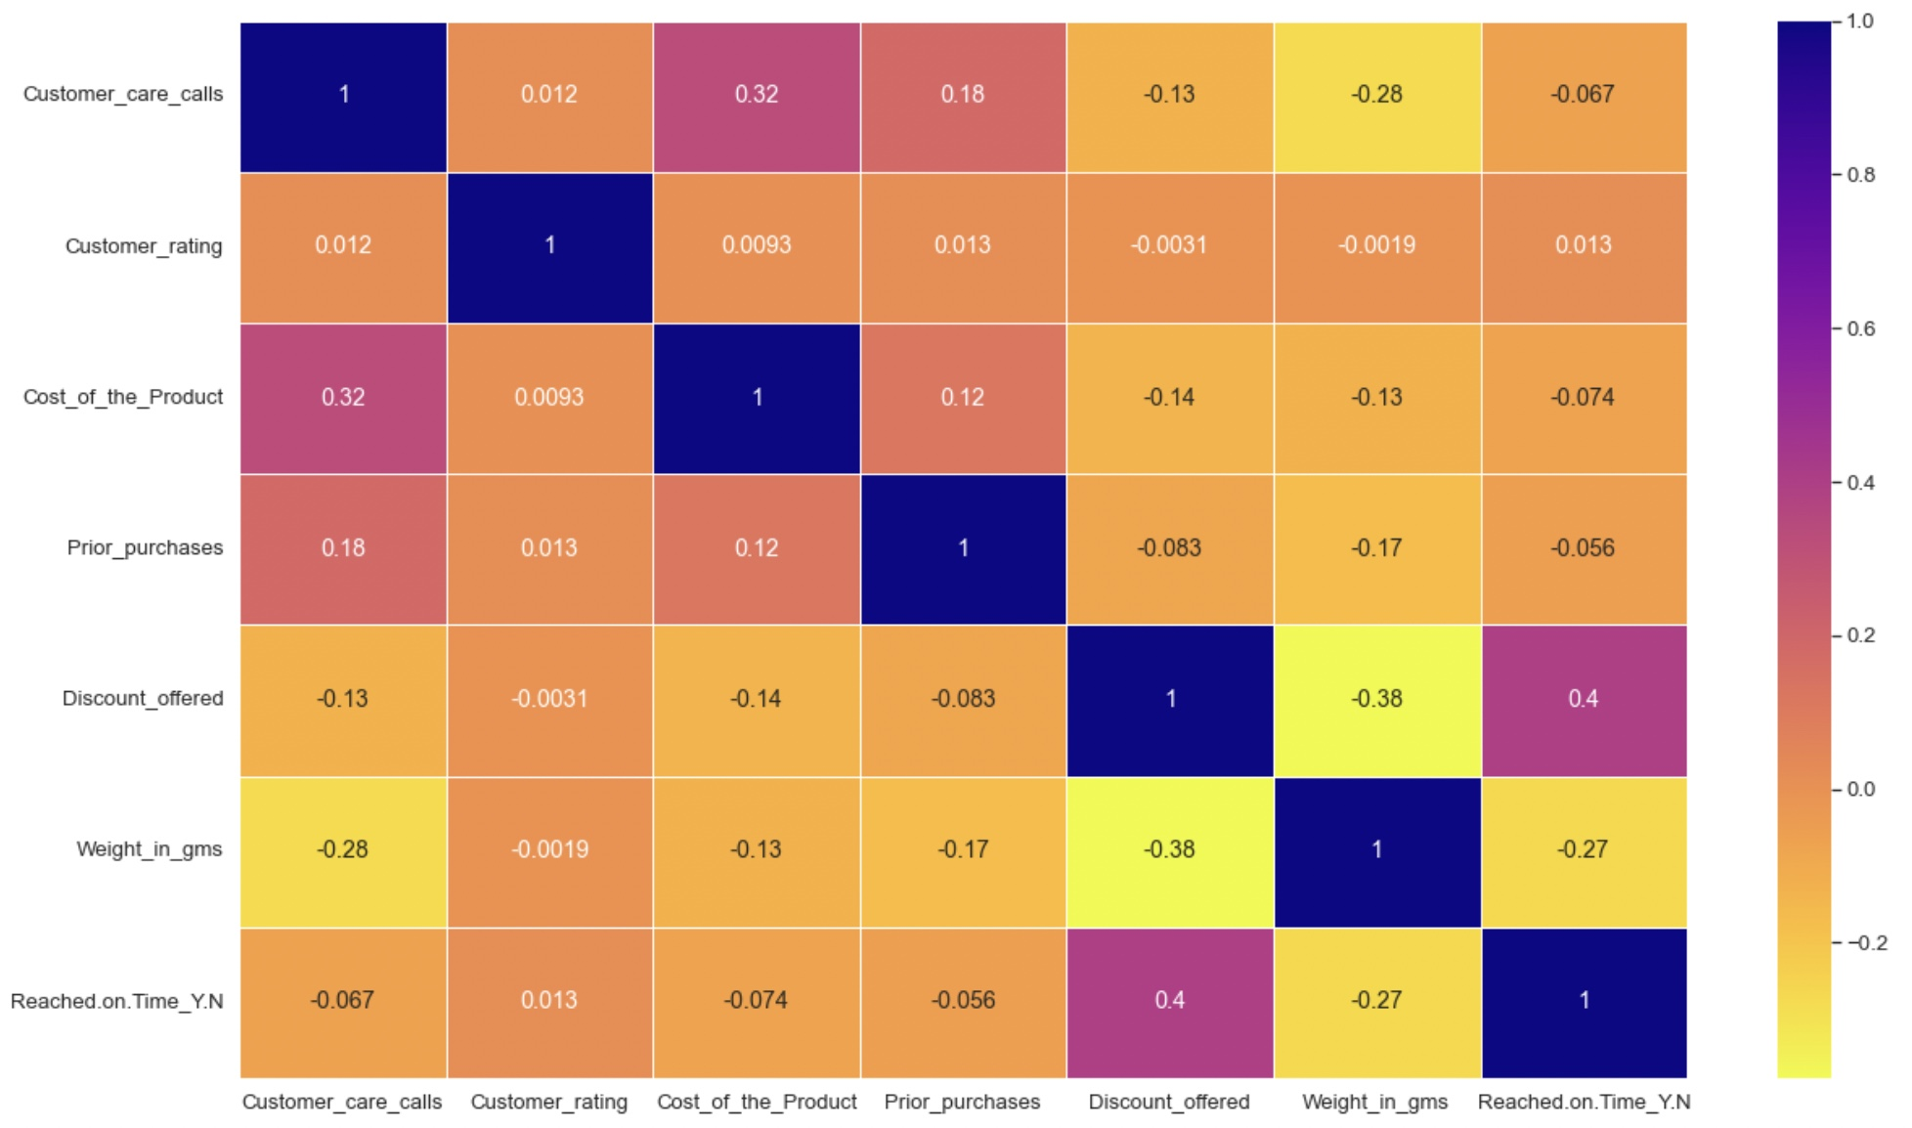
Correlation in Dataset
Customer Calls and Cost of the Product have more strong relationship compared to other relationships.
That means if our costumer pays more money for product, they have tendency to have more customer care calls.

Slide 15
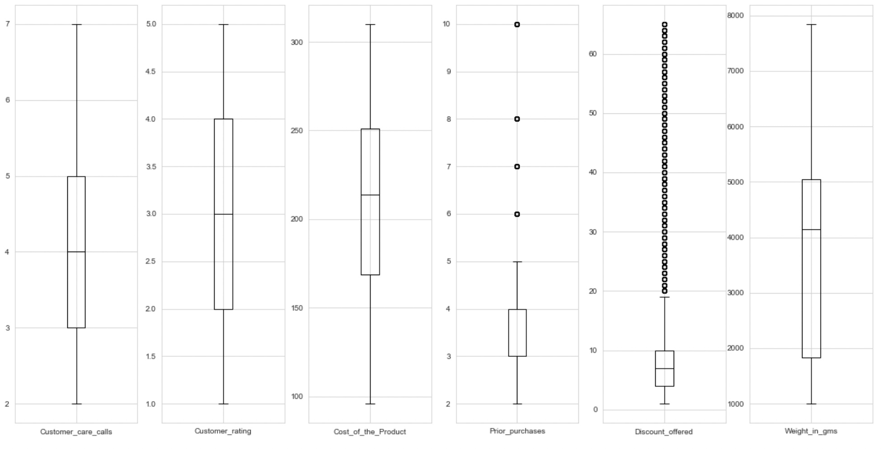
Outlier Detection
It seems like we have a outliers for Prior purchases & Discount Offer we might have some outliers.

Slide 16
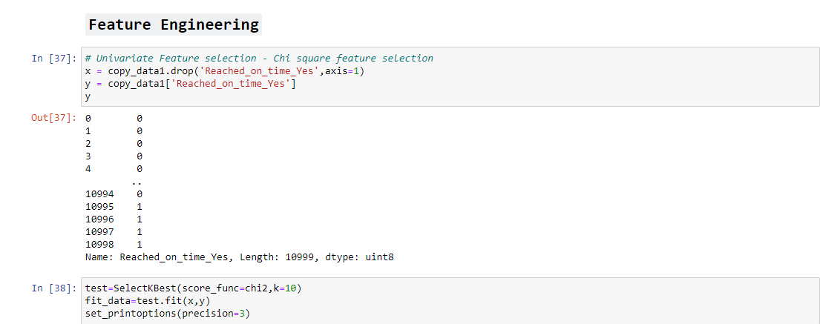
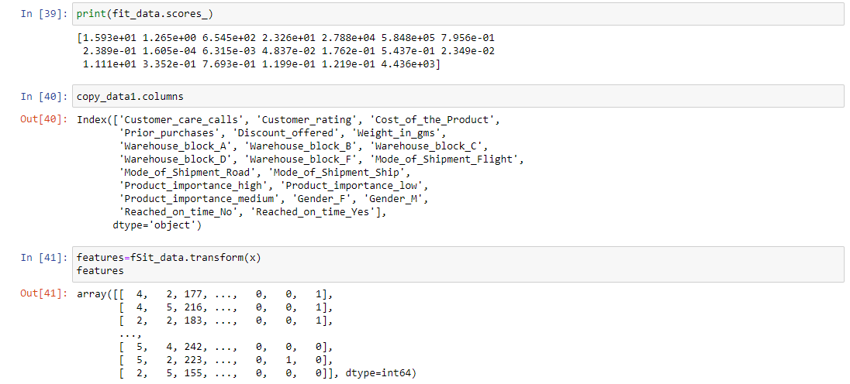
Feature Engineering using chi-square technique

Slide 17
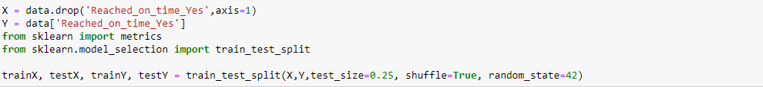
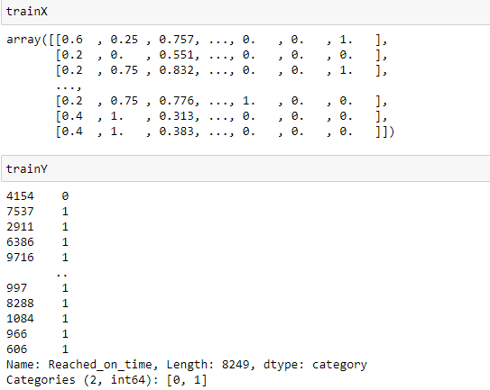
Making Data Ready For Model Training
Splitting Data into Train-Test split:

Slide 18
Machines Learning Models
Decision Tree Classifier
K-Nearest Neighbor
Random Forest Classifier
AdaBoost Classifier

Slide 19
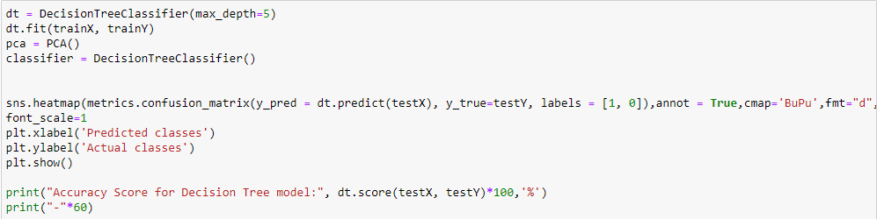
Decision Tree Classifier Accuracy Score for Decision Tree model: 66.86%

Slide 20
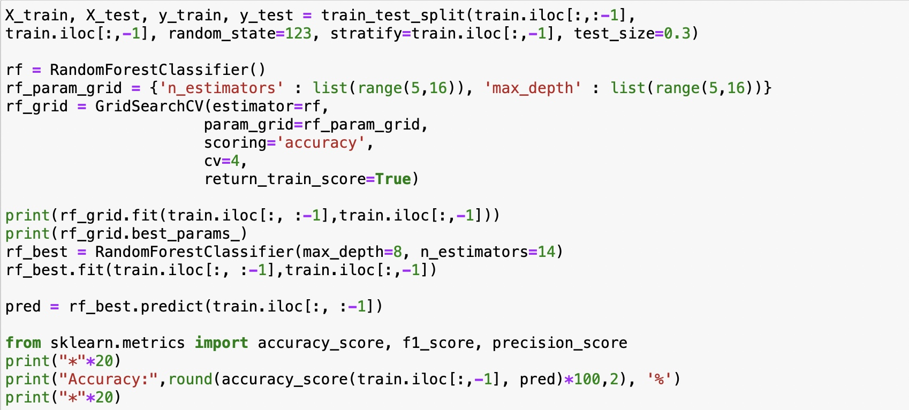
Random Forest Classifier Accuracy Score for Random Forest model: 83.48%

Slide 21
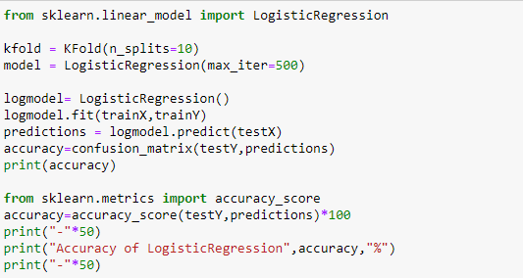
Logistic Regression Classifier Accuracy Score for Logistic Regression Classifier model : 63.68%

Slide 22
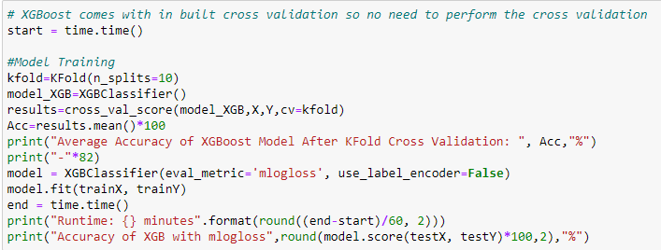
XGBoost Classifier 1. Average Accuracy of XGBoost Model After KFold Cross Validation: 65.45902059723716 % 2. Accuracy Score for XGBoost Classifier model : 63.68%

Slide 23
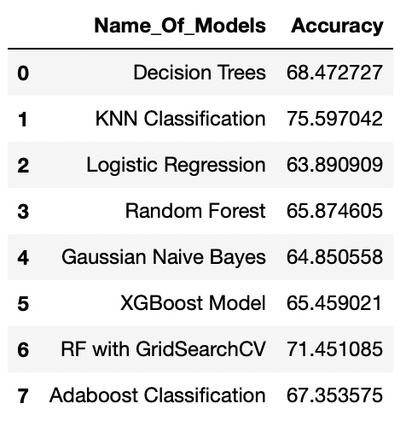
Model Comparison
83.495709

Slide 24
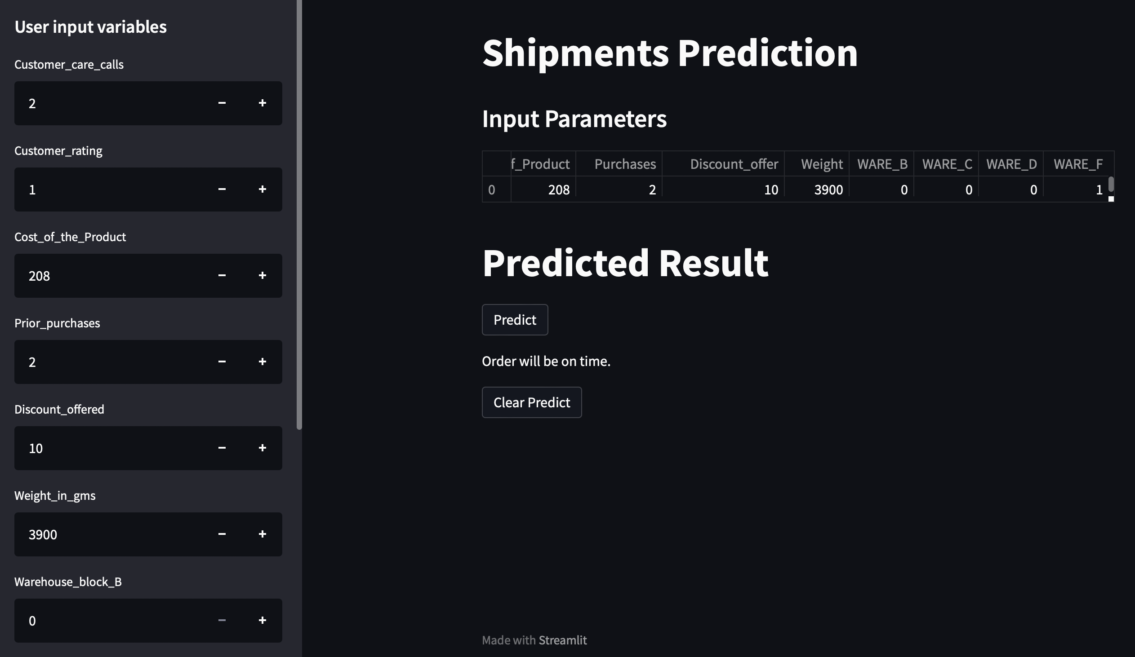
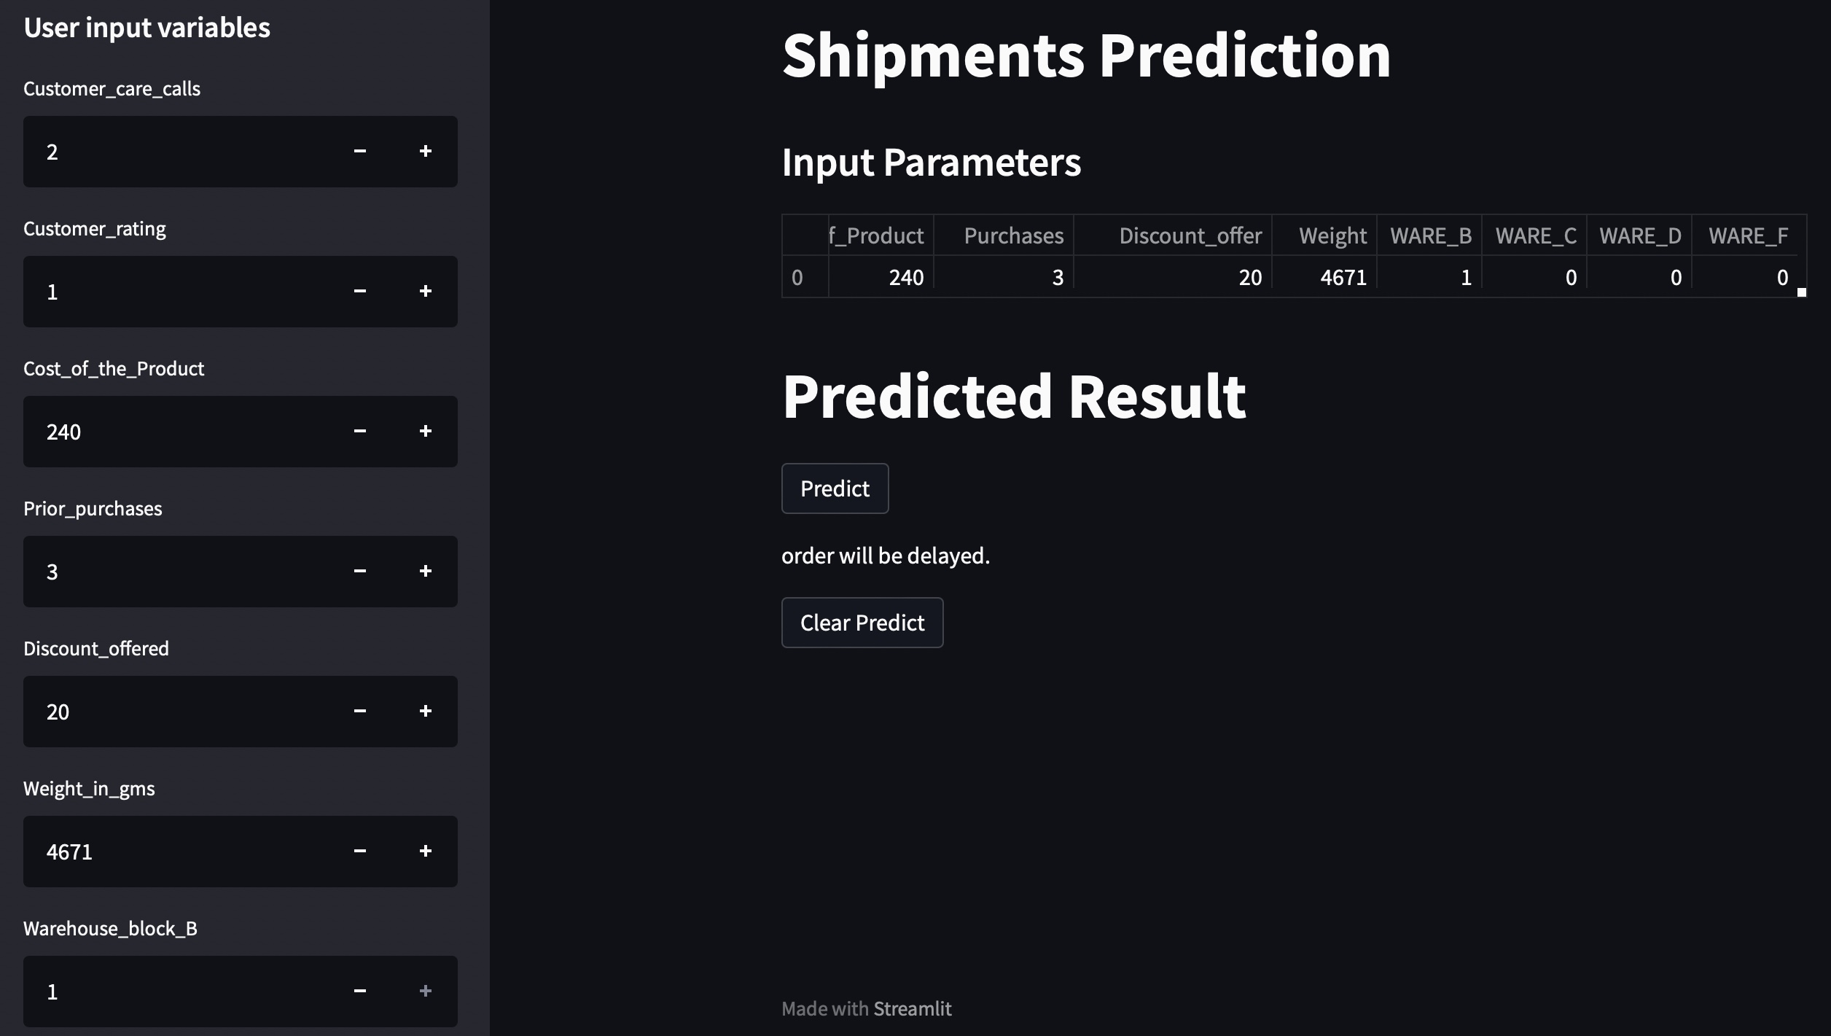
Model Deployment
After the Model building and Evaluation process, we have deployed the code using “Streamlit”.
We have selected the Random Forest because its giving highest accuracy & we used in deployment.

Slide 25
Suggestions for Company
The parcel should not be centralized in the warehouse block F, so that the handling is not too crowded which can cause the late shipment.
The operation team should add more manpower when there is a sale program, especially for the discount more than 10% and the parcel weight is 1 - 4 Kg.

Slide 26
Challenges Faced
While model building with best accuracy , there was challenging related to the categorical and numerical features. We were not getting the best accuracy.
How did you overcome?
We removed outlier which impacting on model accuracy & we also applied hyper parameter tuning with k-fold after than we got best accuracy.

